Slide 1
OSI Protocol Stack
Notes:
Given the post man exemple

Slide 2
Internet structure: network of networks
End systems (clients) connect to Internet via access ISPs (Internet Service Providers)
Access ISPs in turn must be interconnected.
So that any two hosts can send packets to each other
Resulting network of networks is very complex
Evolution was driven by economics and national policies

Slide 3
Protocol “layers”
Networks are complex,
with many “pieces”:
hosts
routers
links of various media
applications
protocols
hardware, software
Question:
is there any hope of organizing structure of network?
…. or at least our discussion of networks?

Slide 4
Why Layering?
Dealing with complex systems:
explicit structure allows identification, relationship of complex system’s pieces
layered reference model for discussion
Modularization eases maintenance, updating of system
change of implementation of layer’s service transparent to rest of system
e.g., change in gate procedure doesn‘t affect rest of system

Slide 5
ISO/OSI Reference Model
presentation: allow applications to interpret meaning of data, e.g., encryption, compression, machine-specific conventions
session: synchronization, checkpointing, recovery of data exchange
Internet stack “missing” these layers!
these services, if needed, must be implemented in application
needed?
application
presentation
session
transport
network
link
physical

Slide 6
Internet Protocol Stack
Application: Actual job of applications.
Session: Combines independent request-responses to the session logic sometimes reflecting transaction of user, real or virtual.
Transport: Creates multiple parallel application-serving delivery channels (called ports) above each network point.
Network: Delivery across networks: from the sending LAN to the receiving LAN using routing.
Data-Link: Delivery within local network (LAN) between directly connected NICs.
Physical: Transfer of ‘1’ and ‘0’ bits via electro-magnetic media channels: decoding/encoding, signal detection, calibration, channel creation, frequency, power, modulations, etc.
application
transport
network
link
physical

Slide 7
Internet Protocol Stack
application: supporting network applications
FTP, SMTP, HTTP
transport: process-process data transfer
TCP, UDP
network: routing of datagrams from source to destination
IP, routing protocols
link: data transfer between neighboring network elements
Ethernet, 802.11 (WiFi), PPP
physical: bits “on the wire”
application
transport
network
link
physical

Slide 8

Encapsulation
source
message
M
application
transport
network
link
physical
segment
H_{t}
M
H_{t}
datagram
H_{n}
H_{n}
H_{t}
M
frame
H_{l}
H_{n}
H_{t}
M
link
physical
switch
destination
H_{n}
H_{t}
M
network
link
physical
application
transport
network
link
physical
M
H_{l}
H_{n}
H_{t}
M
H_{n}
H_{t}
M
H_{t}
M
H_{n}
H_{t}
M
H_{l}
H_{n}
H_{t}
M
router

Slide 9
The Complete Packet
Application Header
Presentation Header
Session Header
Transport Header
Network Header
Data Link Header
Frame Preamble
Data
Data Link Traler(CRC)
Packet

Slide 10
Packet Components
Header
Data
Trailer
9
Introduction 1-9

Slide 11
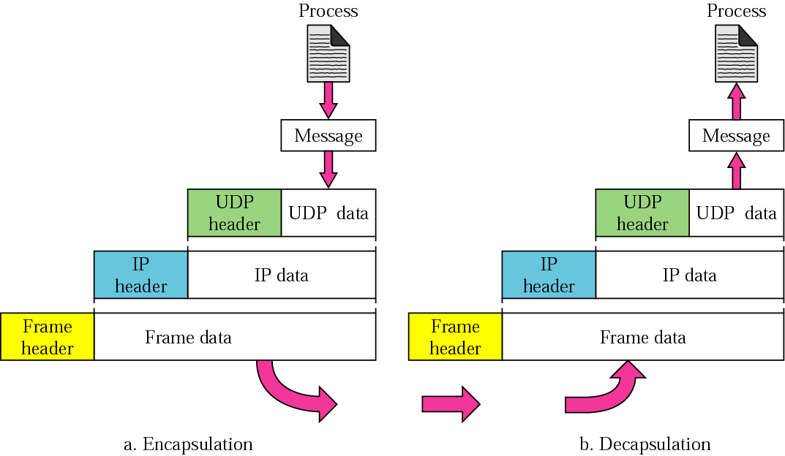
Encapsulation and decapsulation

Slide 12
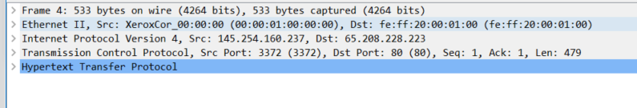

Slide 13
Application Layer
The set of (of protocols that supports) applications that use the network
telnet, ftp, http, smtp, dns, ping, tracert, …
More ??
Doesn’t provide services to any other layer
Application
Transport
Network
Link
Phy

Slide 14
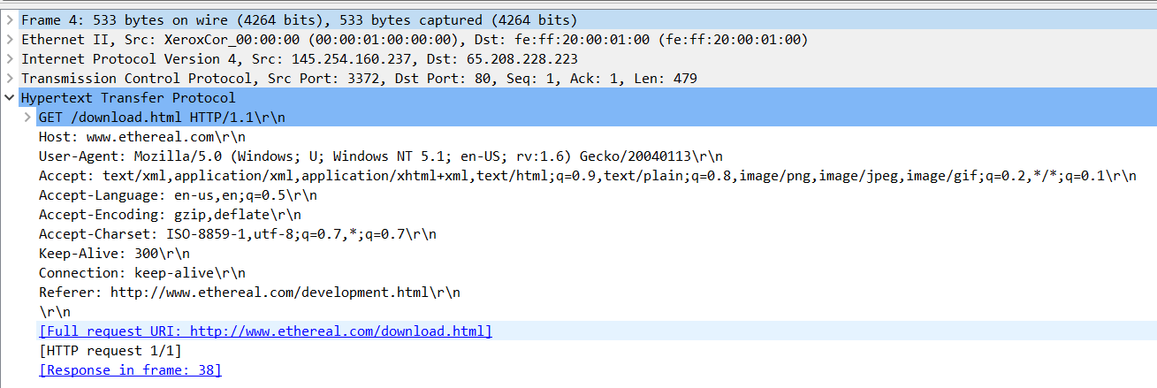

Slide 15
Transport layer - Goal: data transfer between end systems
TCP -Transmission Control Protocol [RFC 793]: Internet’s connection-oriented service
reliable, in-order byte-stream data transfer
flow control
congestion control
UDP - User Datagram Protocol [RFC 768]: Internet’s connectionless service
unreliable data transfer
no flow control
no congestion control

Slide 16
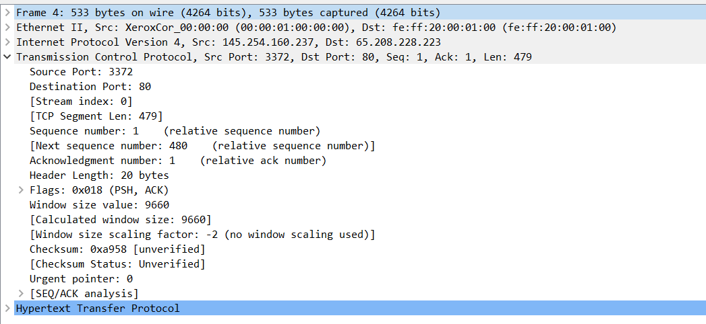

Slide 17
Network Layer
Carries data from source to destination
network layer is provided by Internet Protocol (IP)
found in all end-systems and routers
provides abstraction of end-to-end link
segmentation and reassembly
packet-forwarding, routing, scheduling
unique IP addresses
only best-effort service
chooses which packets to drop
Application
Transport
Network
Link
Phy

Slide 18
Network Layer
Unicast - piece of information is sent from one point to another point in the network
Multicast - piece of information is sent from one or more points to a set of other points
Broadcast - piece of information is sent from one point to all other points in the network
Application
Transport
Network
Link
Phy

Slide 19
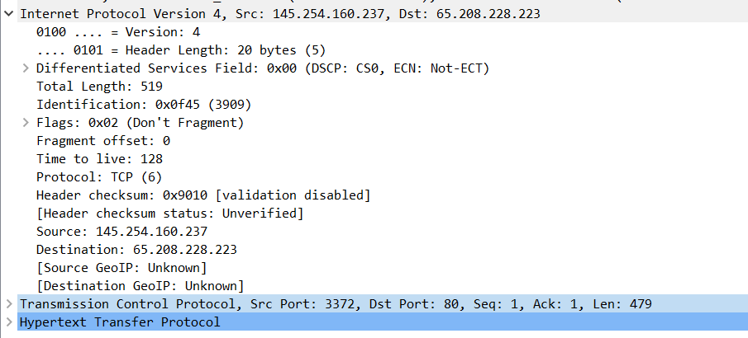

Slide 20
Link Layer
Reliable communication over a single link
Introduces the notion of a frame
set of bits that belong together
Internet
a variety protocols most common is Ethernet
others are FDDI, SONET, HDLC
Dependent on underlying physical link properties.
Link layer protocols are the lower layer of software
How much wires do we need to allow physical transfer in the classroom for
N-students? N* (N-1)/2.
Application
Transport
Network
Link
Phy
Notes:
For 40 students it is 780 wires between all students. Each student will sit with 39 wires – and need to label by name each wire to pass information. This Name Label is actually the identity of the Student's computer – in Networking we use Mac-address.

Slide 21
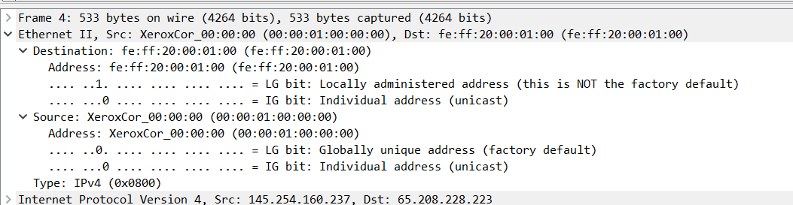

Slide 22
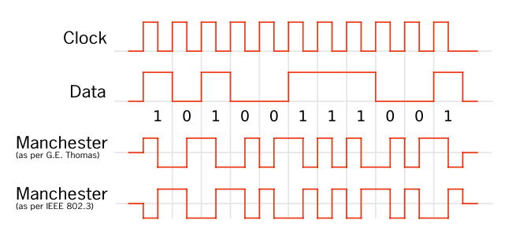
Physical Layer
Moves bits between physically connected end-systems
Coding scheme to represent a bit
Internet: technology to move bits on a wire, wireless link, satellite channel etc.
Application
Transport
Network
Link
Phy

